Slide 1
Chapter 15
Thermodynamics

Slide 2
Chapter 15: Thermodynamics
The first law of thermodynamics
Thermodynamic processes
Thermodynamic processes for an ideal gas
Reversible and irreversible processes
Entropy - the second law of thermodynamics
Statistical interpretation of entropy
The third law of thermodynamics

Slide 3
Thermodynamics
Thermodynamics is the study of the inter-relation between heat, work and internal energy of a system and its interaction with its environment..
Example systems
Gas in a container
Magnetization and demagnetization
Charging & discharging a battery
Chemical reactions
Thermocouple operation
System
Environment
Universe

Slide 4
Thermodynamics States
A state variable describes the state of a system at time t, but it does not reveal how the system was put into that state.
Examples of state variables:
P = pressure (Pa or N/m²),
T = temperature (K),
V = volume (m³),
n = number of moles, and
U = internal energy (J).
Notes:
Could incorporate personal response system questions from the College Physics by G/R/R 2E ARIS site (www.mhhe.com/grr), Instructor Resources: CPS by eInstruction, Chapter 15, Questions 2 and 18.

Slide 5
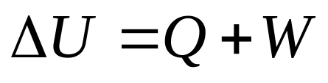
The First Law of Thermodynamics
The first law of thermodynamics says the change in internal energy of a system is equal to the heat flow into the system plus the work done on the system (conservation of energy).
Notes:
Could incorporate personal response system questions from the College Physics by G/R/R 2E ARIS site (www.mhhe.com/grr), Instructor Resources: CPS by eInstruction, Chapter 15, Questions 1 and 8.

Slide 6
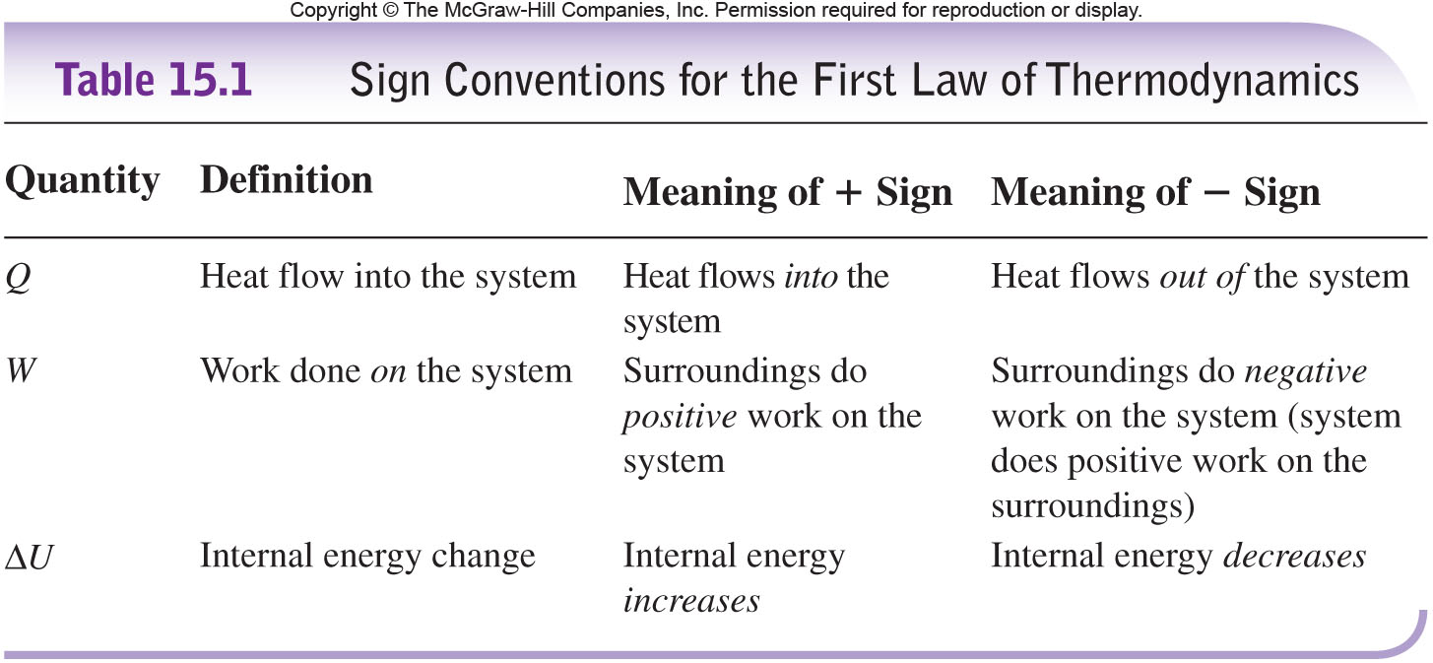
Sign Conventions

Slide 7
Sign Conventions - Other Physics Texts
“In some chemistry and engineering books, the first law of thermodynamics is written as Q = ΔU -W’. The equations are the same but have a different emphasis. In this expression W’ means the work done by the environment on the system and is thus the negative of our work W, or W = -W’.
The first law was discovered by researchers interested in building heat engines. Their emphasis was on finding the work done by the system, W, not W’.
Since we want to understand heat engines, the historical definition is adopted. W means the work done by the system.”
-College Physics, Wilson, Buffa & Lou, 6th ed., p. 400.

Slide 8
Sign Conventions - Giambattista
Our book uses ΔU = Q +W’ (a rearrangement of the previous slide)
W’ < 0 for the system doing work on the environment.
W’ > 0 for the environment doing work on the system.
Q is the input energy. If W’ is negative then that amount of energy is not available to raise the internal energy of the system.
Our focus is the energy in the ideal gas system. Doing work on the environment removes energy from our system.

Slide 9
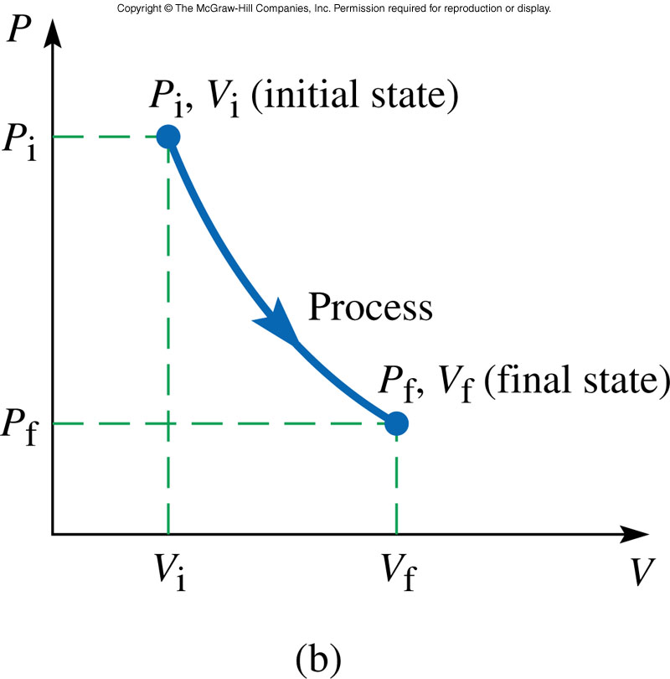
Thermodynamic Processes
A thermodynamic process is represented by a change in one or more of the thermodynamic variables describing the system.
Each point on the curve represents an equilibrium state of the system.
Our equation of state, the ideal gas law (PV = nRT), only describes the system when it is in a state of thermal equilibrium.

Slide 10
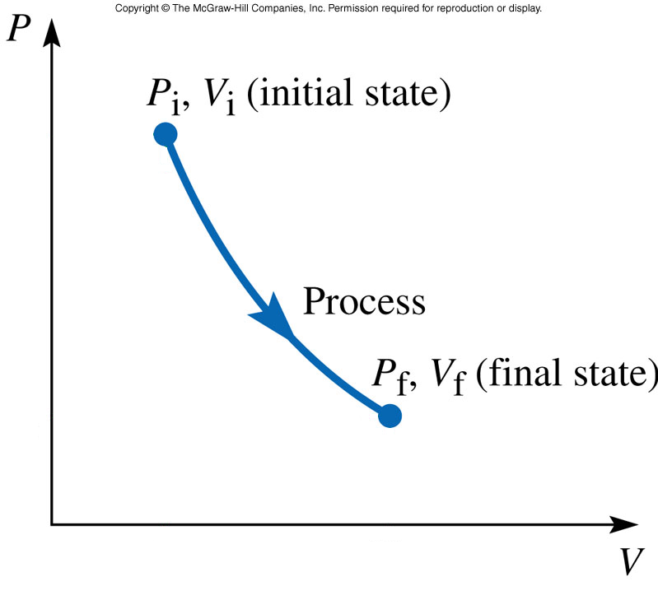
Reversible Thermodynamic Process
For a process to be reversible each point on the curve must represent an equilibrium state of the system.
The ideal gas law (PV = nRT), does not describe the system when it is not in a state of thermal equilibrium.
Reversible Process
Irreversible Process

Slide 11
Thermodynamic Processes
A PV diagram can be used to represent the state changes of a system, provided the system is always near equilibrium.
The area under a PV curve gives the magnitude of the work done on a system. W>0 for compression and W<0 for expansion.

Slide 12
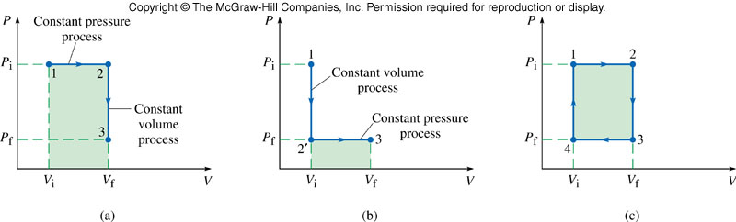
To go from the state (V_{i}, P_{i}) by the path (a) to the state (V_{f}, P_{f}) requires a different amount of work then by path (b). To return to the initial point (1) requires the work to be nonzero.
The work done on a system depends on the path taken in the PV diagram. The work done on a system during a closed cycle can be nonzero.

Slide 13
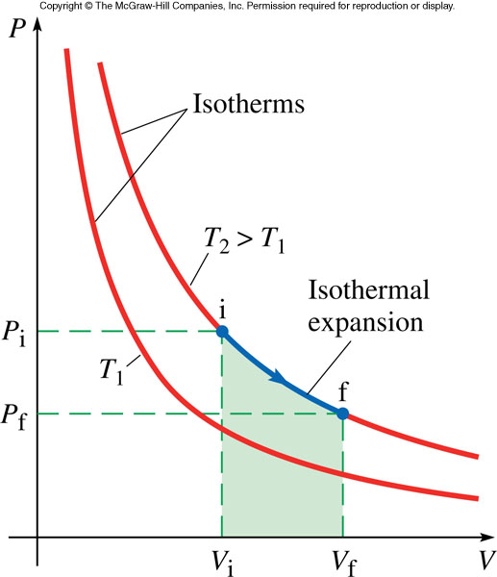
An isothermal process implies that both P and V of the gas change (PV∝T).

Slide 14
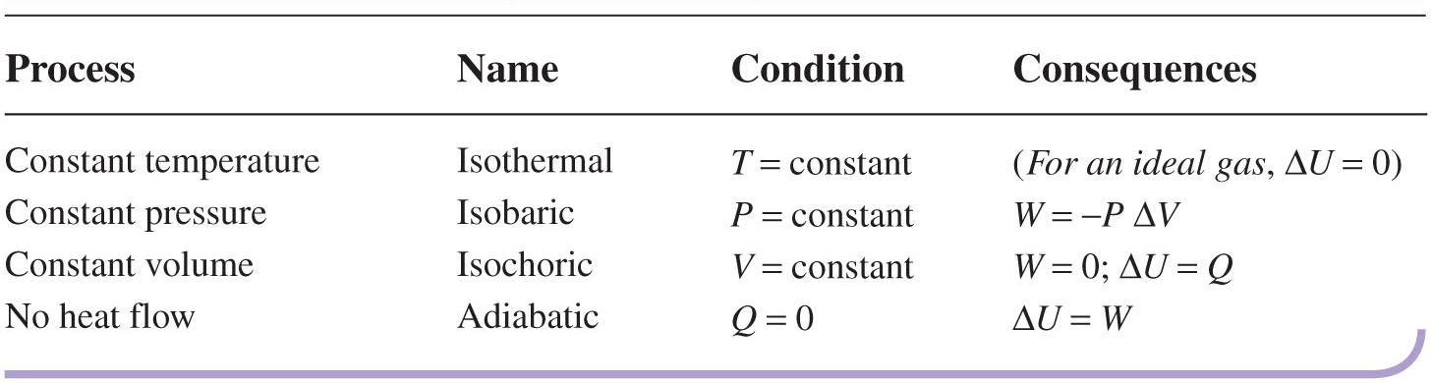
Summary of Thermodynamic Processes

Slide 15
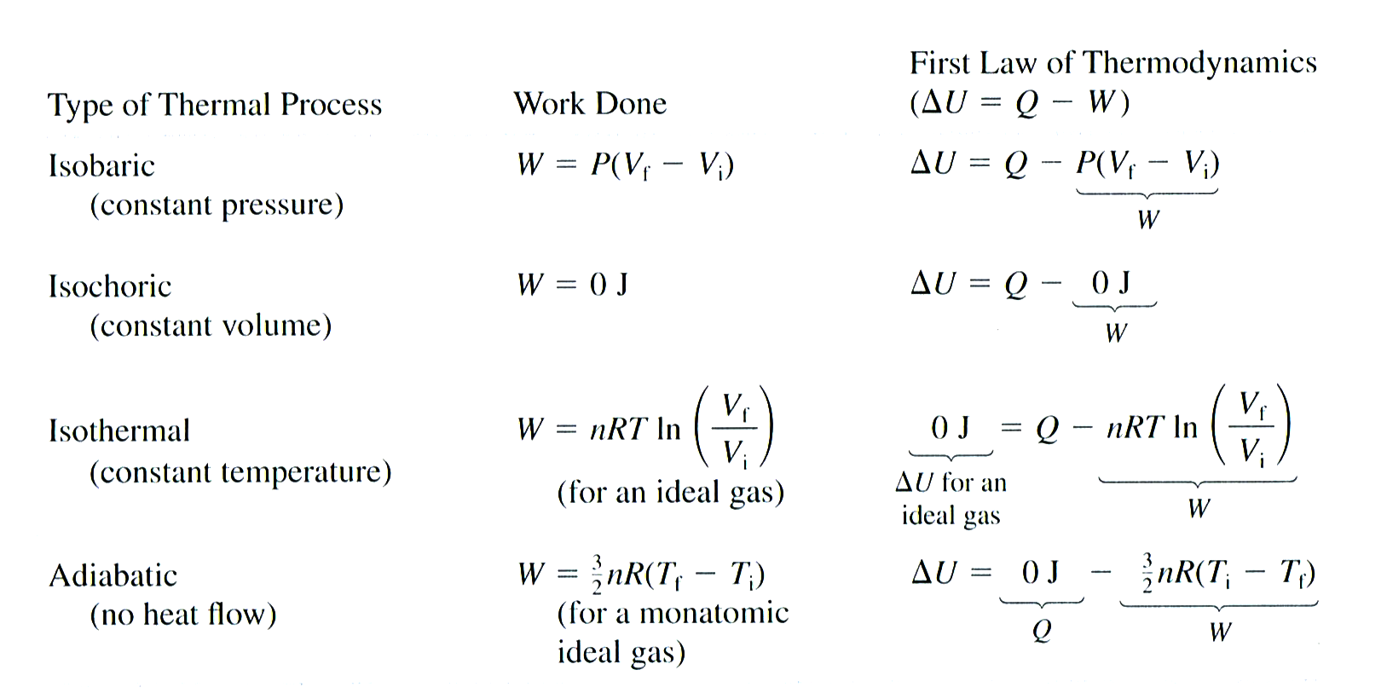


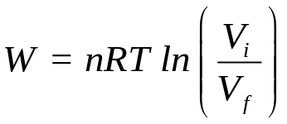
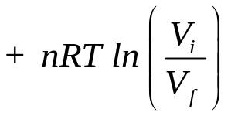
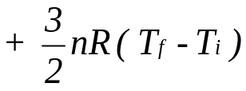
Summary of Thermal Processes
The First Law of Thermodynamics

Slide 16
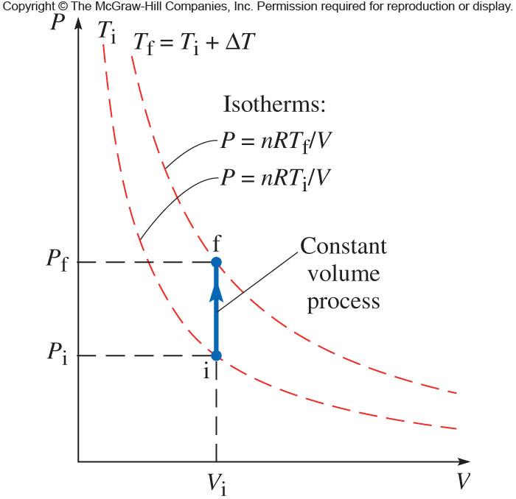
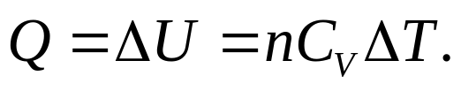
Thermodynamic Processes for an Ideal Gas
No work is done on a system when its volume remains constant (isochoric process). For an ideal gas (provided the number of moles remains constant), the change in internal energy is
Notes:
Could incorporate personal response system questions from the College Physics by G/R/R 2E ARIS site (www.mhhe.com/grr), Instructor Resources: CPS by eInstruction, Chapter 15, Questions 3, 10, 11, 12, 16, 17, 19, and 10.

Slide 17

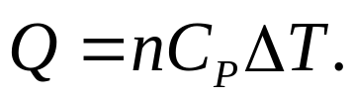
For a constant pressure (isobaric) process, the change in internal energy is
where
and
C_{P} is the molar specific heat at constant pressure. For an ideal gas C_{P} = C_{V} + R.

Slide 18
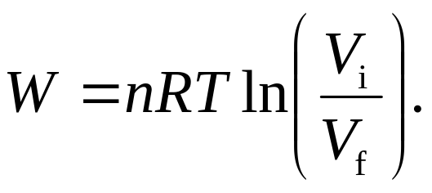
For a constant temperature (isothermal) process, ΔU = 0 and the work done on an ideal gas is

Slide 19
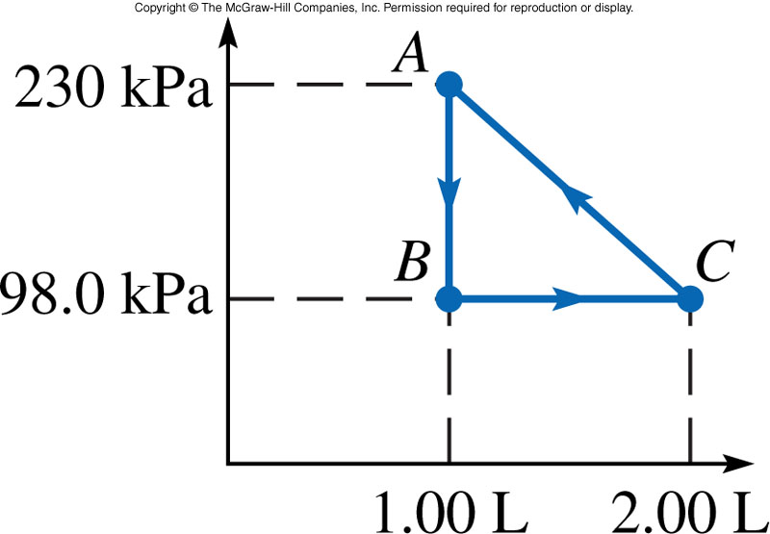
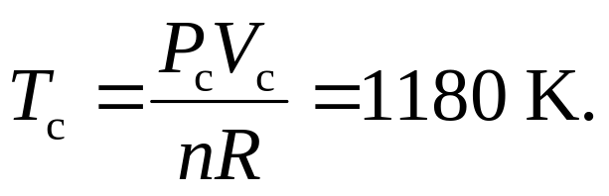
Example (text problem 15.7): An ideal monatomic gas is taken through a cycle in the PV diagram.
(a) If there are 0.0200 mol of this gas, what are the temperature and pressure at point C?
From the graph: P_{c} = 98.0 kPa
Using the ideal gas law

Slide 20
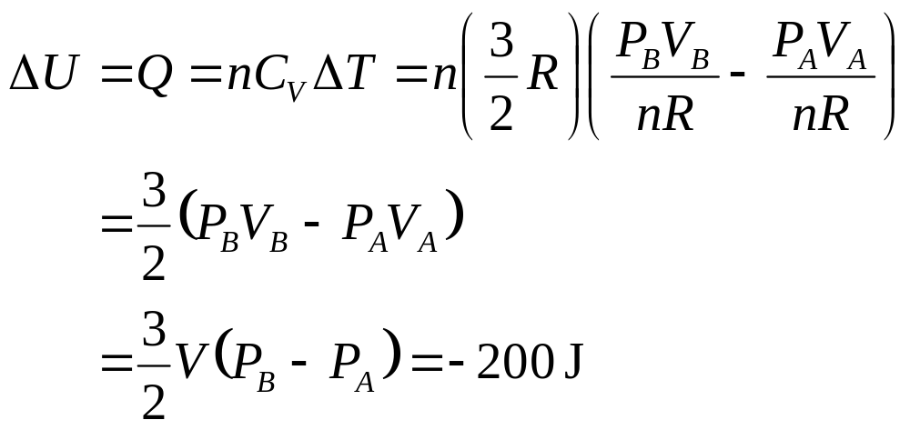
Example continued:
(b) What is the change in internal energy of the gas as it is taken from point A to B?
This is an isochoric process so W = 0 and ΔU = Q.

Slide 21
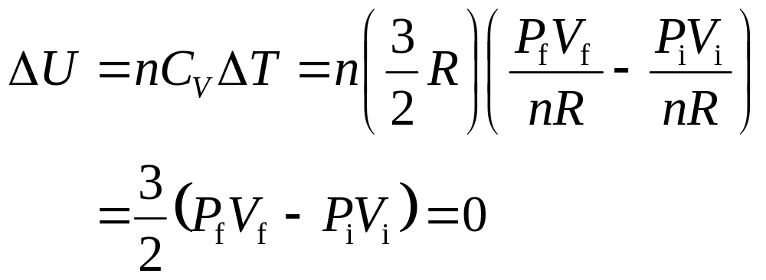
Example continued:
(c) How much work is done by this gas per cycle?
The work done per cycle is the area between the curves on the PV diagram. Here W=½ΔVΔP = 66 J.
(d) What is the total change in internal energy of this gas in one cycle?
The cycle ends where it began (ΔT = 0).

Slide 22
Example (text problem 15.8):
An ideal gas is in contact with a heat reservoir so that it remains at constant temperature of 300.0 K. The gas is compressed from a volume of 24.0 L to a volume of 14.0 L. During the process, the mechanical device pushing the piston to compress the gas is found to expend 5.00 kJ of energy.
How much heat flows between the heat reservoir and the gas, and in what direction does the heat flow occur?
This is an isothermal process, so ΔU = Q + W = 0 (for an ideal gas) and W = −Q = −5.00 kJ. Heat flows from the gas to the reservoir.

Slide 23
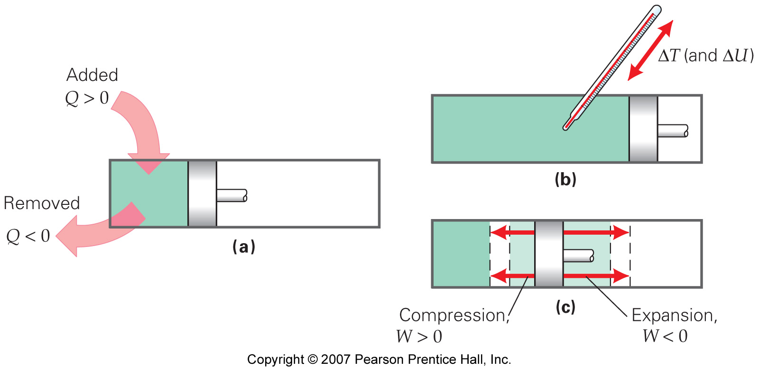
First Law of Thermodynamics
Internal Energy
ΔU = Q + W (Conservation of Energy)
Heat Energy
Work Done

Slide 24
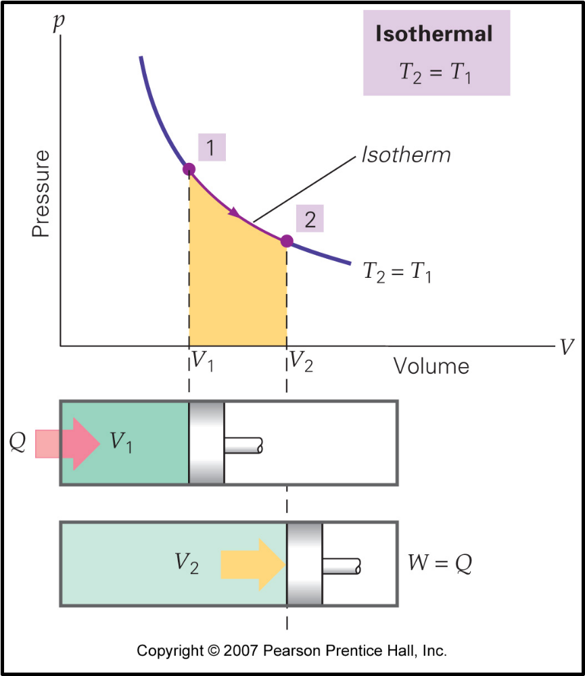
Isothermal Process
W = -Q

Slide 25
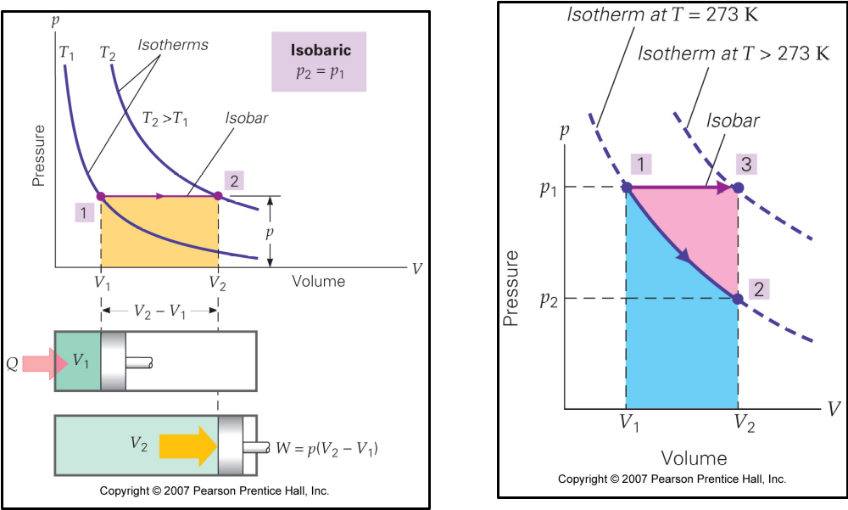
Isobaric Process
W = -p(V₂ - V₁)

Slide 26
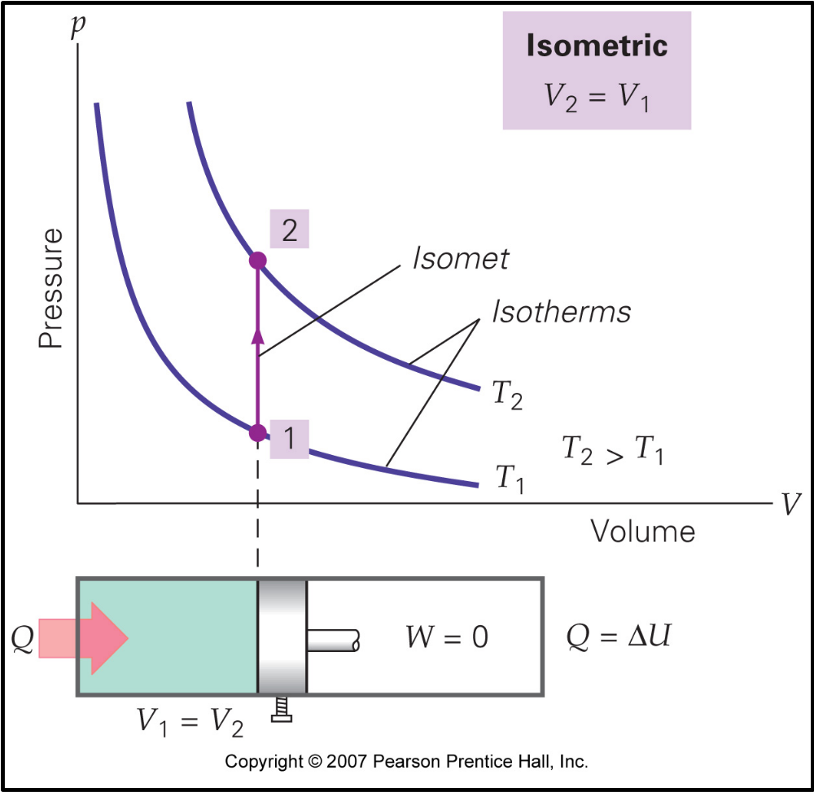
Isometric Process

Slide 27
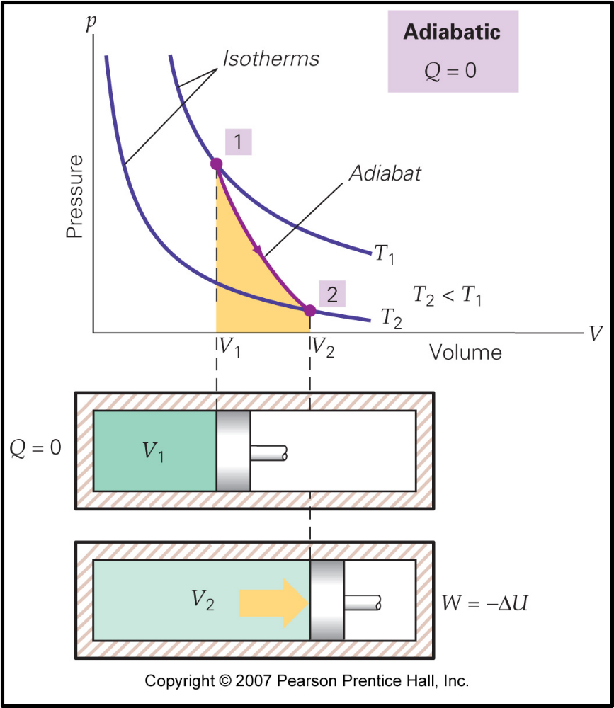
Adiabatic Process
W = ΔU

Slide 28
Reversible and Irreversible Processes
A process is reversible if it does not violate any law of physics when it is run backwards in time.
For example an ice cube placed on a countertop in a warm room will melt.
The reverse process cannot occur: an ice cube will not form out of the puddle of water on the countertop in a warm room.
Notes:
Could incorporate personal response system questions from the College Physics by G/R/R 2E ARIS site (www.mhhe.com/grr), Instructor Resources: CPS by eInstruction, Chapter 15, Question 4.

Slide 29
Reversible and Irreversible Processes
A collision between two billiard balls is reversible. Momentum is conserved if time is run forward; momentum is still conserved if time runs backwards.

Slide 30
The Second Law of Thermodynamics
The second law of thermodynamics (Clausius Statement): Heat never flows spontaneously from a colder body to a hotter body.
Any process that involves dissipation of energy is not reversible.
Any process that involves heat transfer from a hotter object to a colder object is not reversible.

Slide 31
Entropy
Entropy is a state variable and is not a conserved quantity.
Entropy is a measure of a system’s disorder.
Heat flows from objects of high temperature to objects at low temperature because this process increases the disorder of the system.

Slide 32
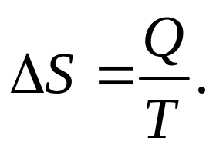
Entropy
If an amount of heat Q flows into a system at constant temperature, then the change in entropy is
Every irreversible process increases the total entropy of the universe. Reversible processes do not increase the total entropy of the universe.

Slide 33
The Second Law of Thermodynamics
(Entropy Statement)
The entropy of the universe never decreases.

Slide 34
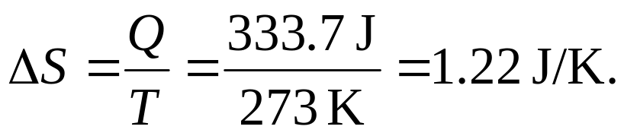
Example (text problem 15.48):
An ice cube at 0.0 °C is slowly melting.
What is the change in the ice cube’s entropy for each 1.00 g of ice that melts?
To melt ice requires Q = mL_{f} joules of heat. To melt one gram of ice requires 333.7 J of energy.
The entropy change is

Slide 35
Statistical Interpretation of Entropy
A microstate specifies the state of each constituent particle in a thermodynamic system.
A macrostate is determined by the values of the thermodynamic state variables.

Slide 36
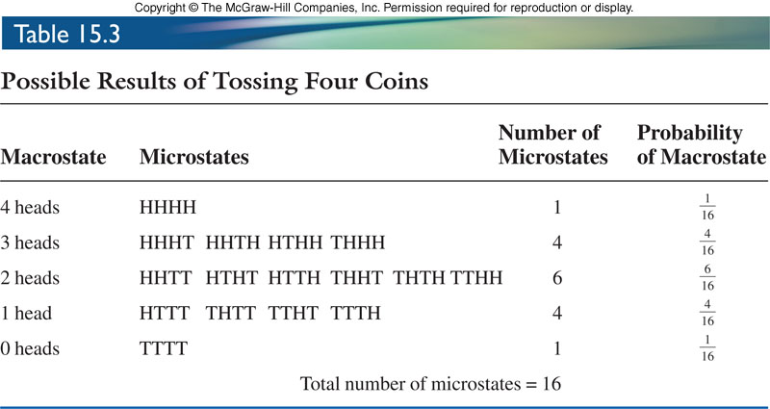
Notes:
Table from the 2nd edition.

Slide 37

The number of microstates for a given macrostate is related to the entropy.
where Ω is the number of microstates.

Slide 38
Example (text problem 15.61):
For a system composed of two identical dice, let the macrostate be defined as the sum of the numbers showing on the top faces.
What is the maximum entropy of this system in units of Boltzmann’s constant?

Slide 39
Example continued:
Sum | Possible microstates
2 | (1,1)
3 | (1,2); (2,1)
4 | (1,3); (2,2); (3,1)
5 | (1,4); (2,3); (3,2); (4,1)
6 | (1,5); (2,4), (3,3); (4,2); (5,1)
7 | (1,6); (2,5); (3,4), (4,3); (5,2); (6,1)
8 | (2,6); (3,5); (4,4) (5,3); (6,2)
9 | (3,6); (4,5); (5,4) (6,3)
10 | (4,6); (5,5); (6,4)
11 | (5,6); (6,5)
12 | (6,6)

Slide 40

Example continued:
The maximum entropy corresponds to a sum of 7 on the dice. For this macrostate, Ω = 6 with an entropy of

Slide 41
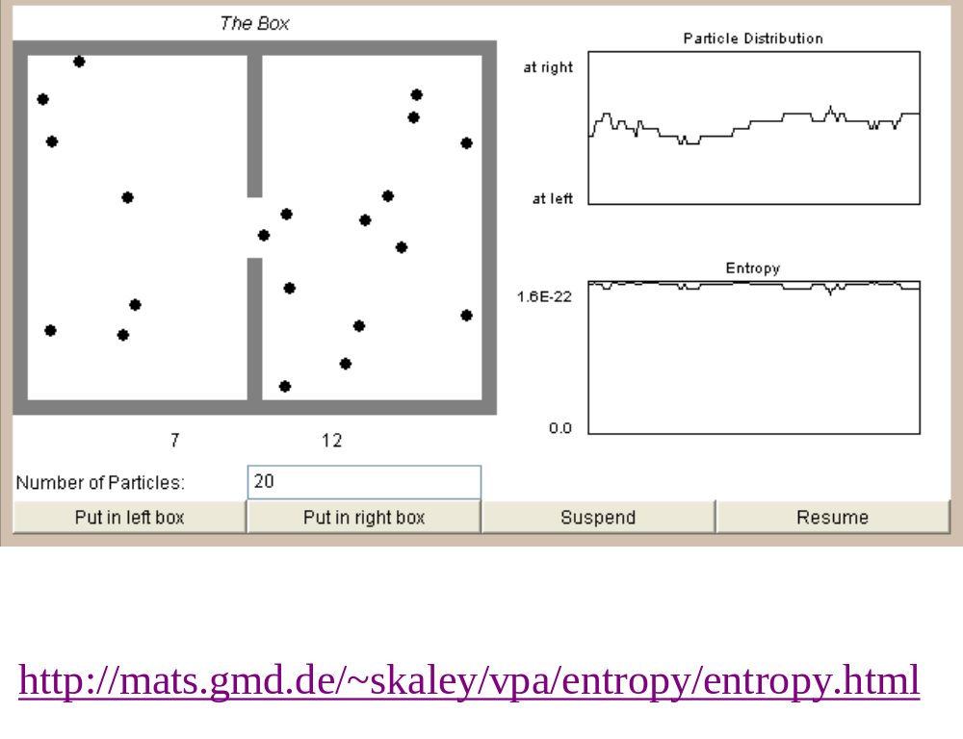
The Disappearing Entropy Simulation

Slide 42
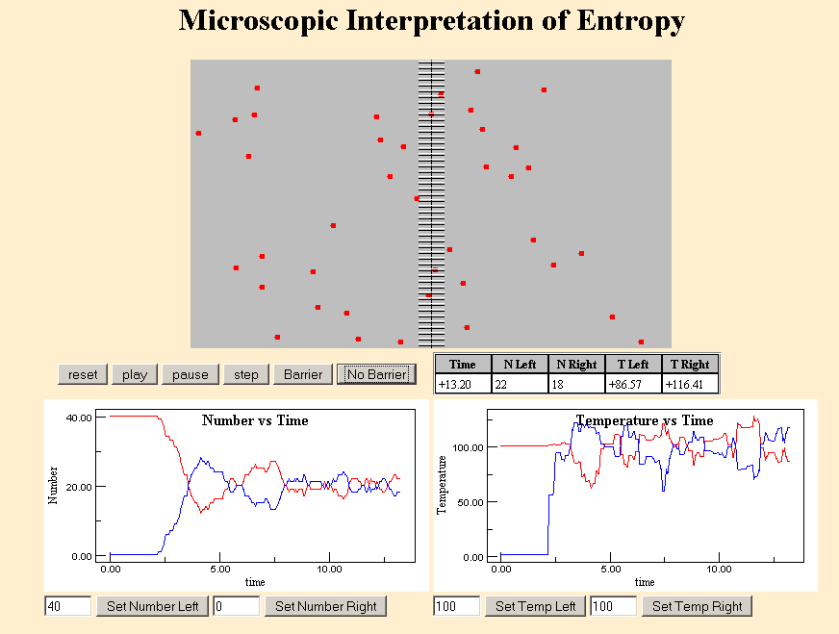
http://ww2.lafayette.edu/~physics/files/phys133/entropy.html

Slide 43
The number of microstates for a given macrostate is related to the entropy.
where Ω is the number of microstates.
Ω =(n₁ + n₂)!/(n₁! x n₂!)
  n₁ is the number of balls in the box on the left.
  n₂ is the number of balls in the box on the right.

Slide 44
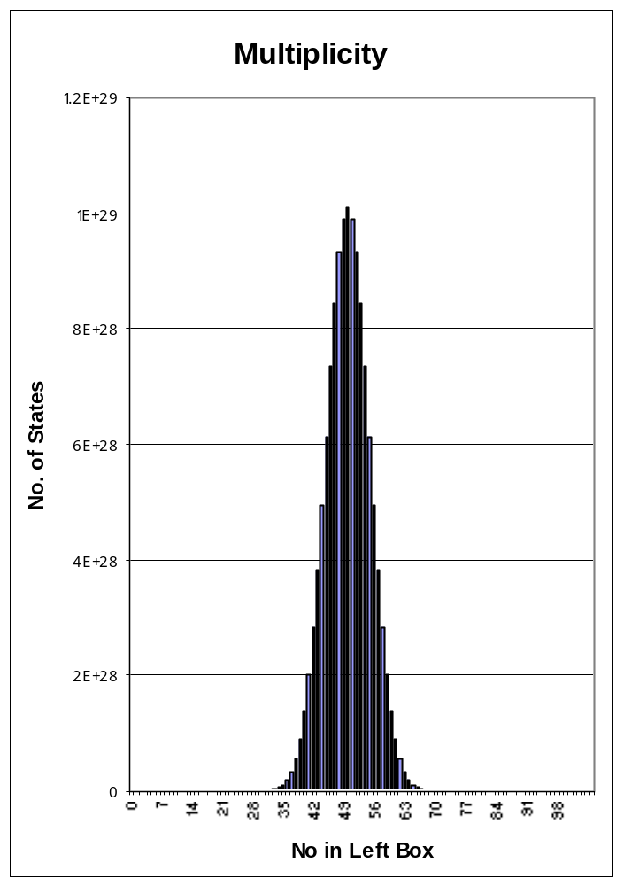
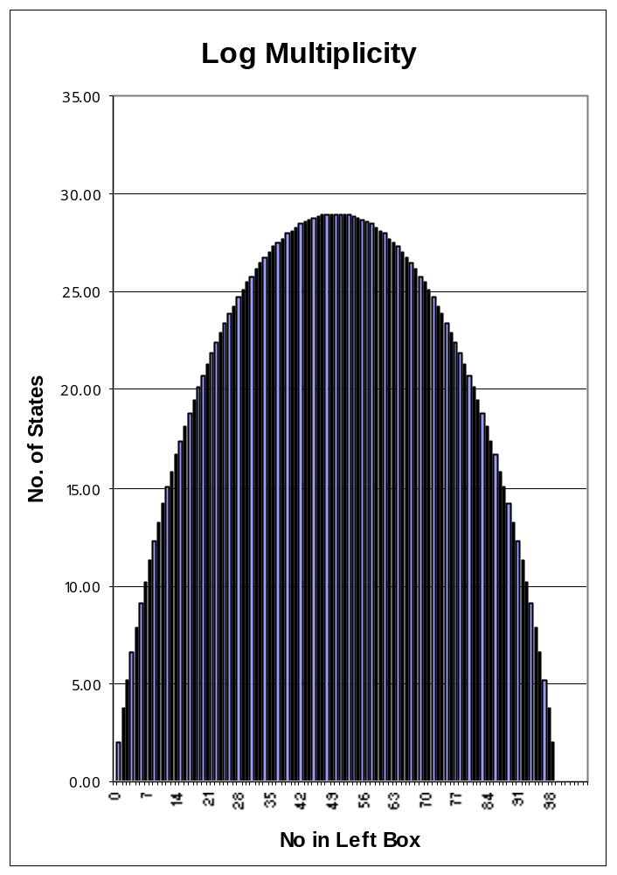
Equilibrium is the Most Probable State N=100

Slide 45
The Third Law of Thermodynamics
The third law of thermodynamics is a statistical law of nature regarding entropy and the impossibility of reaching absolute zero of temperature. The most common enunciation of third law of thermodynamics is:
“ As a system approaches absolute zero, all processes cease and the entropy of the system approaches a minimum value.”
It is impossible to cool a system to absolute zero by a process consisting of a finite number of steps.

Slide 46
Heat Engine Operation

Slide 47
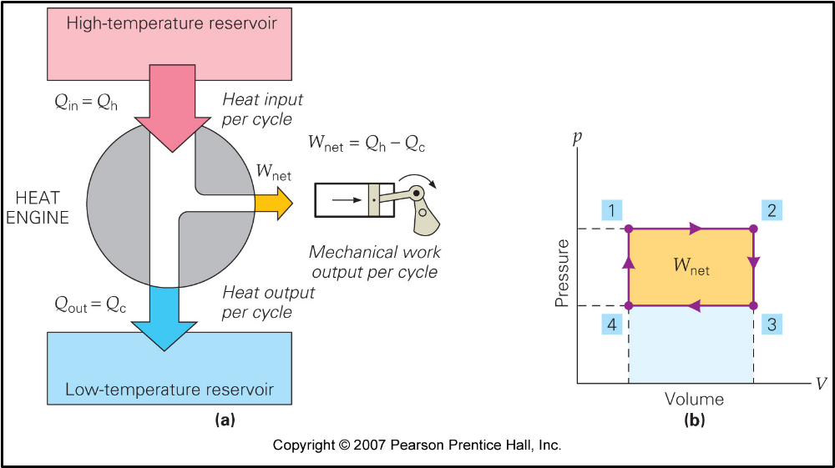
Heat Engine Operation

Slide 48
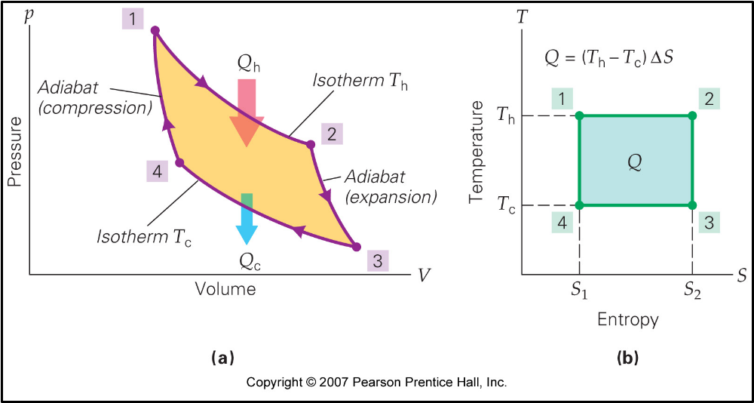
Carnot Cycle - Ideal Heat Engine

Slide 49
Carnot Cycle - Ideal Heat Engine
Process efficiency
T_{L}
ή = 1 - ---------
T_{H}
No heat engine can run at 100% efficiency. Therefore T_{L} can never be zero. Hence absolute zero is unattainable.

Slide 50
The British scientist and author C.P. Snow had an excellent way of remembering the three laws:
1. You cannot win (that is, you cannot get something for nothing, because matter and energy are conserved).
2. You cannot break even (you cannot return to the same energy state, because there is always an increase in disorder; entropy always increases).
3. You cannot get out of the game (because absolute zero is unattainable).

Slide 51
Summary
The first law of thermodynamics
Thermodynamic processes
Thermodynamic processes for an ideal gas
Reversible and irreversible processes
Entropy - the second law of thermodynamics
Statistical interpretation of entropy
The third law of thermodynamics

Slide 52
Extra

Slide 53
Ensemble = mental collection of N systems with identical macroscopic constraints, but microscopic states of the systems are different.
Microcanonical ensemble represents an isolated system (no energy or particle exchange with the environment).

